Slide 1
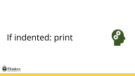
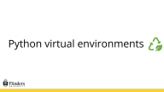
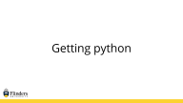
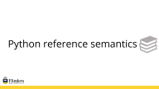
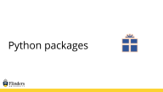
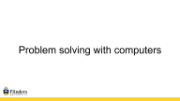
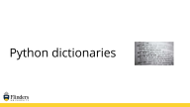
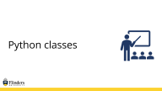
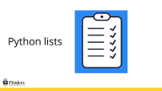
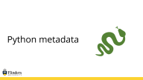
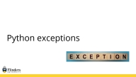
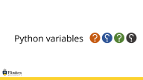
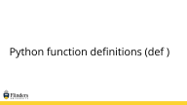
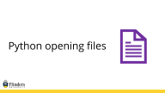

Slide 2
Problem solving with computers

Slide 3
Problem solving with computers
Introduction to Python

Slide 4
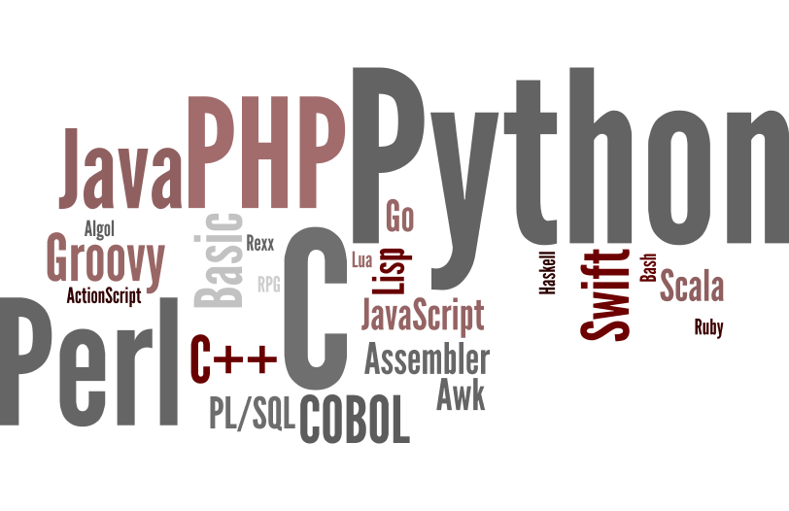
There are lots of languages you could use

Slide 5
Python
The zen of python
Beautiful is better than ugly
Explicit is better than implicit
Simple is better than complex
Complex is better than complicated
Readability counts
Praised for look and feel
Spaces rule!
Use PyCharm, iPython, Spyder, or IDLE

Slide 6
The Zen of Python
Beautiful is better than ugly. Explicit is better than implicit. Simple is better than complex. Complex is better than complicated. Flat is better than nested. Sparse is better than dense. Readability counts. Special cases aren't special enough to break the rules. Although practicality beats purity.
Errors should never pass silently. Unless explicitly silenced. In the face of ambiguity, refuse the temptation to guess. There should be one-- and preferably only one --obvious way to do it. Although that way may not be obvious at first unless you're Dutch. Now is better than never. Although never is often better than *right* now. If the implementation is hard to explain, it's a bad idea. If the implementation is easy to explain, it may be a good idea. Namespaces are one honking great idea -- let's do more of those!
import this

Slide 7
Python
Object oriented
Install libraries from pypi with pip
matplotlib
scipy
numpy
scikitlearn
Python for GIS
Widely used in web programming
regular expressions via re & match

Slide 8
R
Optimized for statistical analysis and data visualization
Built by statisticians
Leans heavily on statistical models
Install libraries from CRAN
tidyverse for data science
Use Rstudio

Slide 9
XML
A markup language
Not really used for scripting
<tag> …. </tag>

Slide 10
HTML
HyperText Markup Language
It is the web!
Variant of XML
Standard is currently HTML 5.0
Defined by World Wide Web Consortium (W3C) and Web Hypertext Application Technology Working Group (WhatWG)
Markup language not for design!

Slide 11
Javascript
Web design
Client side computation (tricky!)
Can be run client side as a VM (Node.js)
Asynchronous execution
JQuery
Web design
Javascript extension
Include from a CDN (most users already have)
Makes life simple!

Slide 12
Perl
Considered an old language
There is more than one way to do it
Sigils ($, @, %)
Glue language
Criticized for look and feel
If you need something look in CPAN
regular expressions via =~ m/ /

Slide 13
Ruby
Relative “newcomer”
Everything is an Object
Principle of least astonishment
regular expressions via =~ / / or match
Installs packages from gem
Use Koans to learn ruby

Slide 14
Which one to use!

Slide 15
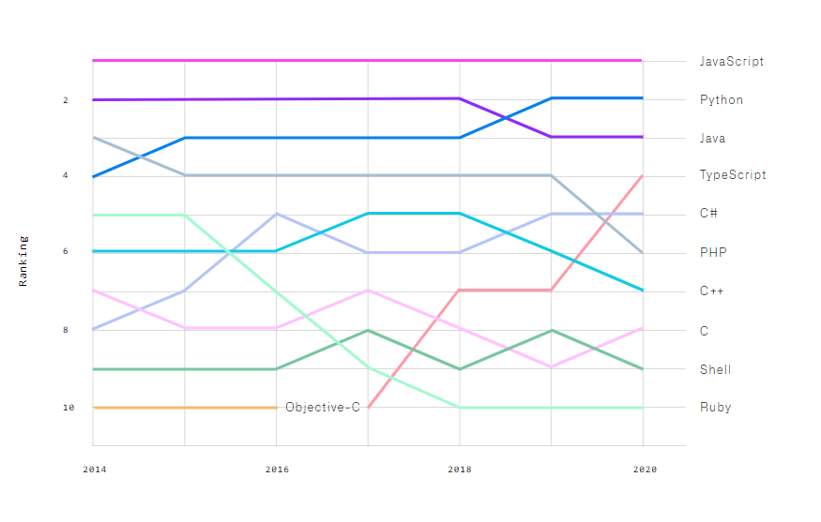
Language Popularity in GitHub

Slide 16
Getting python

Slide 17
Getting python
Download from python.org (don’t do this!)
Install with conda (don’t do this)
Install PyCharm (https://www.jetbrains.com/pycharm)
Note this is available as a virtual app
Install Spyder (https://www.spyder-ide.org/)
Versions: use version 3 at least (probably 3.9 or 3.10)
For any language, use an IDE – it will help with debugging and the silly mistakes
You should probably remember this!

Slide 18
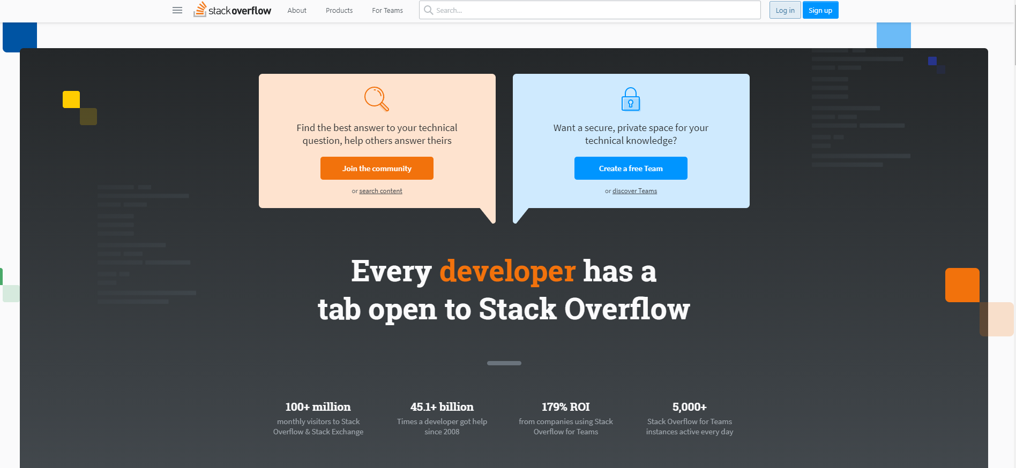
Getting help – https://stackoverflow.com

Slide 19
Getting help
YouTube
The New Boston: https://www.youtube.com/watch?v=HBxCHonP6Ro&list=PL6gx4Cwl9DGAcbMi1sH6oAMk4JHw91mC_
Other videos: https://www.youtube.com/results?search_query=python+tutorial+for+beginners
Software Carpentry
https://swcarpentry.github.io/python-novice-inflammation/

Slide 20
Getting help
Textbooks

Slide 21




Python variables

Slide 22


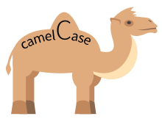

Python variables
Variable names start with a letter
Can contain letters or numbers
Case sensitive
Do not overwrite functions!
print(x)
print(x2)
print(Other_Variable)
print(other_variable)
print = 2
print(print)
Traceback (most recent call last):
File "<input>", line 1, in <module>
TypeError: 'int' object is not callable
x = 2
x2 = 2
OtherVariable = 2
other_variable = 2
Print = 2
print(Print) # Works, but do NOT do!
You should probably remember this!

Slide 23
Python variables
Good variable names
Unique
Don’t override built in functions
About 4 to 8 letters (don’t want to type too much)
Meaningful relative to the variable (e.g. first_name, phone_number, etc)
Use standard names when applicable (np, plt, etc)
Bad variable names
Single characters (a, b, l) … sometimes!
Too long (don’t want to type too much)
Similar to other variables (likely to confuse)
You should probably remember this!

Slide 24
Python variables
No need to declare
Need to assign (initialize)
use of uninitialized variable raises exception
Not typed
if friendly:
greeting = "hello world"
else:
greeting = 12**2
print(greeting)
Everything is a "variable":
Even functions, classes, modules
You should probably remember this!

Slide 25
Python numbers
x = 1 + 2
print(x)
x = x * 2
print(x)
x *= 2
print(x)
x /= 2
print(x)
3
6
12
6
You should probably remember this!

Slide 26
Python numbers
The usual suspects
12, 3.14, 0xFF, 0377, (-1+2)*3/4**5, abs(x), 0<x<=5
C-style shifting & masking
1<<16, x&0xff, x|1, ~x, x^y
Long (arbitrary precision) numbers, complex numbers
2**100 -> 1267650600228229401496703205376
1j**2 -> (-1+0j)
You don’t need to remember this!

Slide 27
Python strings
"hello"+"world" "helloworld" # concatenation
"hello"*3 "hellohellohello" # repetition
"hello"[0] "h" # indexing
"hello"[-1] "o" # (from end)
"hello"[1:4] "ell" # slicing
len("hello") 5 # size
"hello" < "jello" 1 # comparison
"e" in "hello" 1 # search
"escapes: \n etc, \033 etc, \if etc"
'single quotes' """triple quotes""" r"raw strings"
You should probably remember this!

Slide 28

Python lists

Slide 29
Python lists
Just a list of things
Can be mixed (numbers, strings, objects, et)
Use [ ] to define
Variables become the item
Can access each one, or a single one
x = 2
things = [1, 2, x, “Python”]
You should probably remember this!

Slide 30


Python lists
How are you on your first birthday?

Slide 31
Python lists
A collection of things indexed from 0
[0, 1, 2, 3, 4, 5]
You can use range() to go from 0 to n
You should probably remember this!

Slide 32
Python lists
Lists can have mixed things in them!
a = [99, "bottles of beer", ["on", "the", "wall"]]
Access list elements by position
a[0], a[1], a[-2], a[-1], a[1:]
You can set parts of lists
a[0] = 98
a[1:2] = ["bottles", "of", "beer"]
del a[-1]
[98, "bottles of beer", ["on", "the", "wall"]]
[98, "bottles", "of", "beer", ["on", "the", "wall"]]
[98, "bottles", "of", "beer"]
You don’t need to remember this!

Slide 33
Python more lists
a = list(range(5))
[0,1,2,3,4]
Includes first, not last!
a.append(5)
[0,1,2,3,4,5]
a.pop()
[0,1,2,3,4]
Returns 5
a.insert(0, 42)
[42,0,1,2,3,4]
a.pop(0)
[0,1,2,3,4]
Returns 42
a.reverse()
[4,3,2,1,0]
a.sort()
[0,1,2,3,4]
len(a)
Returns 5
You should probably remember some of this!

Slide 34
Python lists can have duplicates, sets cannot
a = [1,1,1,1,1,1,1,1,1]
len(a)
9
b = set([1,1,1,1,1,1,1,1,1])
len(b)
1
You should probably remember this!

Slide 35
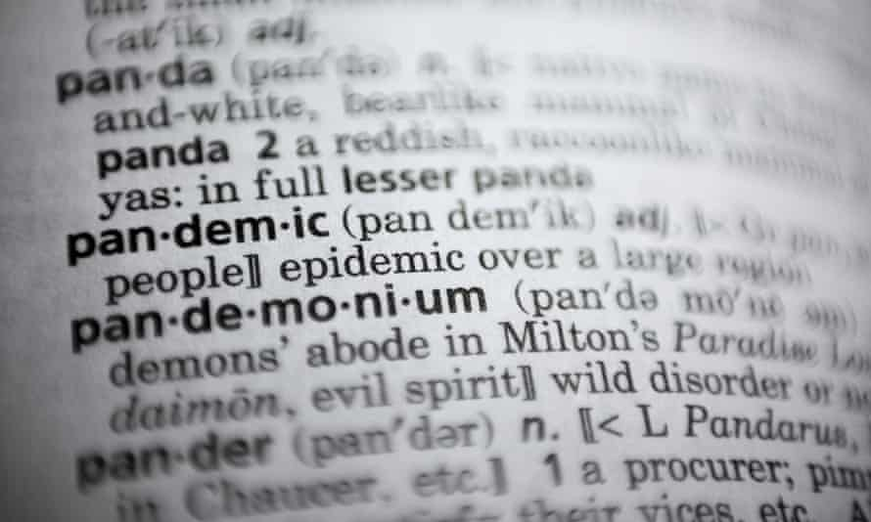
Python dictionaries

Slide 36
Python dictionaries

Slide 37
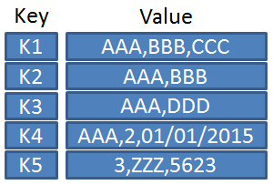
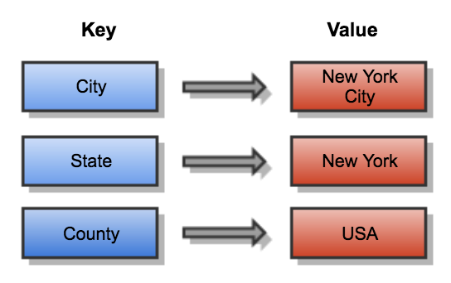
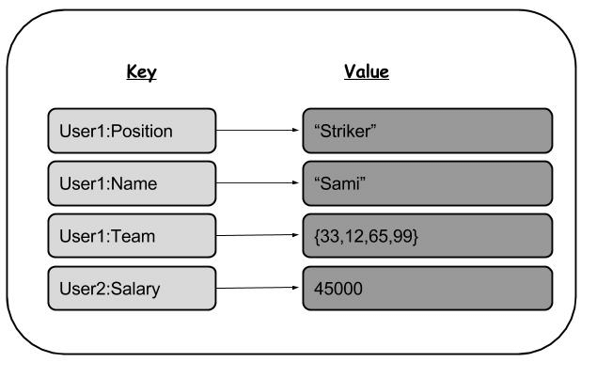
Python dictionaries
Mapping between KEYS and VALUES

Slide 38
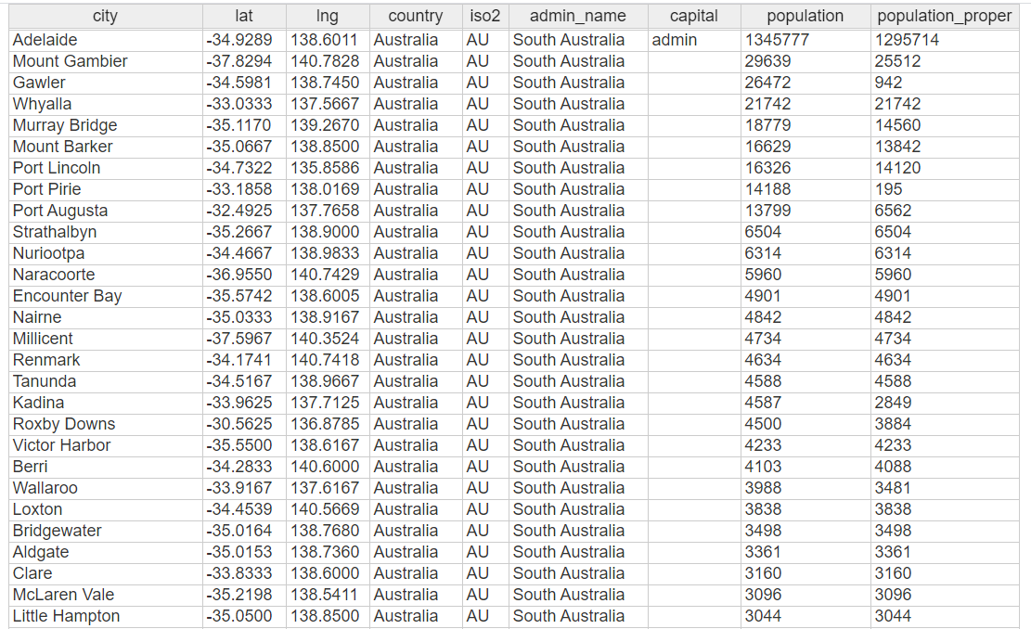
Python dictionaries

Slide 39
Python dictionaries

Slide 40
City name is not unique!
Australia
City of Adelaide, South Australia, a local government area
Canada
Adelaide, a community in the township of Adelaide Metcalfe, Ontario
Adelaide Peninsula, Nunavut
United States
Adelaide, Fremont County, Colorado, a former mining camp
Adelaide, Lake County, Colorado
Adelaide, Georgia
Adelaide Township, Bowman County, North Dakota
Elsewhere
Adelaide, Eastern Cape, South Africa, a town and area
Adelaide Island, an island located off the west coast of the Antarctic Peninsula
Adelaide railway station (Northern Ireland)

Slide 41
Python dictionaries

Slide 42
Python dictionaries
Hash tables, "associative arrays"
d = {"duck": "eend", "water": "water"}
Lookup:
d["duck"] -> "eend"
d["back"]
Delete, insert, overwrite:
del d["water"]
d["back"] = "rug"
d["duck"] = "duik"
# raises KeyError exception
# {"duck": "eend"}
# {"duck": "eend", "back": "rug"}
# {"duck": "duik", "back": "rug"}
You should probably remember this!

Slide 43
Python dictionary operations
Keys, values, items:
d.keys() → ["duck", "back"]
d.values() → ["duik", "rug"]
d.items() → [("duck","duik"), ("back","rug")]
Presence check:
d.has_key("duck") → 1; d.has_key("spam") → 0
“duck” in d; “spam” in d
Values of any type; keys almost any
{"name":"Rob", "age":22, ("hello","world"):1, 42:"yes", "flag": [“green",“yellow"]}
You should probably remember this!

Slide 44
Python dictionary details
Keys must be immutable:
numbers, strings, tuples of immutables
these cannot be changed after creation
reason is hashing (fast lookup technique)
not lists or other dictionaries
these types of objects can be changed "in place"
no restrictions on values
Keys will be listed in arbitrary order
again, because of hashing
You don’t need to remember this!

Slide 45
Python tuples
key = (lastname, firstname)
point = x, y, z # parentheses optional
x, y, z = point # unpack
lastname = key[0]
singleton = (1,) # trailing comma!!!
empty = () # parentheses!
tuples vs. lists; tuples immutable
You don’t need to remember this!

Slide 46

Python reference semantics

Slide 47
Python reference semantics
Assignment manipulates references
x = y does not make a copy of y
x = y makes x reference the object y references
Very useful; but beware!
Example:
>>> a = [1, 2, 3]
>>> b = a
>>> a.append(4)
>>> print b
[1, 2, 3, 4]
You don’t need to remember this!

Slide 48
Changing a shared list
a
1
2
3
a = [1, 2, 3]
a
1
2
3
b = a
b
a
1
2
3
a.append(4)
4
b
You don’t need to remember this!

Slide 49
Changing integers
a
1
a = 1
a
1
new int object created
by add operator (1+1)
b = a
b
a
2
old reference deleted
by assignment (a=...)
a = a+1
1
b
You don’t need to remember this!

Slide 50

If indented: print

Slide 51
If indented: print
Strings, numbers, etc …. Just define using =
Lists have [ ] around them (like the L)
Dictionaries have { } around them and key: value format
You must declare a variable before you use it!

Slide 52
Remember this!!
Strings, numbers, etc …. Just define using =
Lists have [ ] around them (like the L)
Dictionaries have { } around them and key: value format
You must declare a variable before you use it!

Slide 53
Python printing
print(“hello world”) → Print a string
print(myname) → Print a variable
print(f“Hello {myname}”) → These are called f-strings: mixed things
print(f”Salary {salary:,.2f}”) → Automatically formats commas and decimal places
print(“Hello”, end=“ ”) → No newline, adds a space!

Slide 54
Python indentation uses spaces
You will remember this!

Slide 55
Python control statements
if condition:
statements
[elif condition:
statements] ...
else:
statements
while condition:
statements
for var in list (or set or dict, etc):
statements
break
continue
You should probably remember this!

Slide 56
Python indentation uses spaces
In Python:
for i in range(20):
if 0 == i%3:
print(i)
if 0 == i%5:
print("Bingo!")
print("---")
In C:
for (i = 0; i < 20; i++)
{
if (i%3 == 0) {
printf("%d\n", i);
if (i%5 == 0) {
printf("Bingo!\n");
}
}
printf("---\n");
}
0
Bingo!
---
---
---
3
---
---
---
6
---
---
---
9
---
---
---
12
---
---
---
15
Bingo!
---
---
---
18
---
---
You don’t need to remember this!

Slide 57

A quick tip!
When comparing a variable to a value, try to put the value first!
if 0 == x:
if 2 == p:
if len(p) == x:
If you make a mistake and forget the second = then you will get an error
if 0 = x:
print(“yes”)
SyntaxError: invalid syntax
Note: Python is smarter
and will give you an error either
way, but this is still a good rule of
thumb

Slide 58
Python function definitions (def )

Slide 59
Python function definitions (def )
def name(arg1, arg2, ...):
"""documentation""" # optional documentation
statements
return expression # from function
You should probably remember this!

Slide 60
Python functions
Use
def xxxx(a, b, c):
… spaces! ….
MUST be declared before you call it (ie. At the top of the file)
Can call functions from functions
Variables only exist in the function (scope)
You should probably remember this!

Slide 61
Example python function
def gcd(a, b):
"greatest common divisor"
while a != 0:
a, b = b%a, a # parallel assignment
return b
>>> gcd.__doc__
'greatest common divisor'
>>> gcd(12, 20)
4
You should probably remember this!

Slide 62
Example python function
def factorial(a):
“factorial of a number"
if a == 1:
return 1
return a * factorial(a-1)
>>> factorial.__doc__
' factorial of a number '
>>> factorial(5)
120
>>>factorial(6)
720
You should probably remember this!

Slide 63
Example python function
def abyx(a):
“multiply a by x”
x = 2
return a * x
>> abyx(3)
6
>>print(x)
Traceback (most recent call last):
File "<input>", line 1, in <module>
NameError: name 'x' is not defined
You should probably remember this!

Slide 64

Python exceptions

Slide 65
Python exceptions
def foo(x):
return 1/x
def bar(x):
try:
print(foo(x))
except ZeroDivisionError as e:
print("Can’t divide by zero:", e)
bar(2)
bar(0)
0.5
Can’t divide by zero: division by zero
You don’t need to remember this!

Slide 66
Python exceptions
def foo(x):
return 1/x
def bar(x):
try:
print(foo(x))
except ZeroDivisionError as e:
print("Can’t divide by zero:", e)
bar(2)
bar(0)
0.5
Can’t divide by zero: division by zero
You don’t need to remember this!

Slide 67
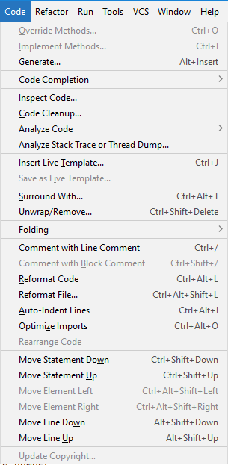
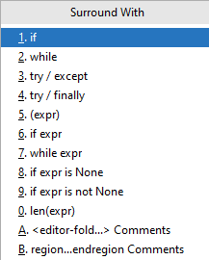
Python exceptions
Surround things that throw exceptions with try/except
try:
print(foo(x))
except ZeroDivisionError as e:
print("Can’t divide by zero:", e)
You don’t need to remember this!

Slide 68

Python classes

Slide 69
Python classes
class name:
"documentation"
statements
-or-
class name(base1, base2, ...):
...
Most, statements are method definitions:
def name(self, arg1, arg2, ...):
...
May also be class variable assignments
You don’t need to remember this!

Slide 70
Example Python class
class Stack:
"A well-known data structure…"
def __init__(self): # constructor
self.items = []
def push(self, x):
self.items.append(x) # the sky is the limit
def pop(self):
x = self.items[-1] # what happens if it’s empty?
del self.items[-1]
return x
def empty(self):
return len(self.items) == 0 # Boolean result
You don’t need to remember this!

Slide 71
Using Python Classes
To create an instance, simply call the class object:
x = Stack() # no 'new' operator!
To use methods of the instance, call using dot notation:
x.empty() # -> 1
x.push(1) # [1]
x.empty() # -> 0
x.push("hello") # [1, "hello"]
x.pop() # -> "hello" # [1]
To inspect instance variables, use dot notation:
x.items # -> [1]
You don’t need to remember this!

Slide 72
Python modules
A module is a collection of stuff in foo.py file
functions, classes, variables
Importing modules:
import re
from re import match
Import with rename:
import re as regex
from re import match as m
import re
print re.match("[a-z]+", s)
from re import match
print match("[a-z]+", s)
import re as regexp
print regexp.match("[a-z]+", s)
from re import match as m
print m("[a-z]+", s)
You don’t need to remember this!

Slide 73
Python modules
import re
Imports all the methods in re
Uses more memory than explicit import (but you won’t notice)
Slower than explicit import (but you won’t notice)
from re import match
Only imports this method (and things it requires)
Reduces potential for namespace collisions
import matplotlib.pyplot as plt
Import numpy as np
You don’t need to remember this!

Slide 74

Python packages

Slide 75
Python packages
Collection of modules in directory
Must have __init__.py file
May contain subpackages
Import syntax:
from P.Q.M import foo; print foo()
from P.Q import M; print M.foo()
import P.Q.M; print P.Q.M.foo()
import P.Q.M as M; print M.foo()
You don’t need to remember this!

Slide 76
Python packages
Download Python packages from https://pypi.org/ … but don’t do that!
Use pip to install python packages. It will install all dependencies
pip install matplotlib
pip install numpy
pip install PhiSpy
USE PYTHON VIRTUAL ENVIRONMENTS!!!
You should probably remember this!

Slide 77

Python virtual environments

Slide 78
Python virtual environments
A self-contained environment
Only has the modules you need
Exportable/shareable
Versioning
Less conflicts
You should probably remember this!

Slide 79



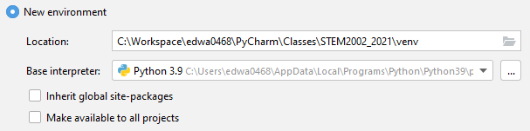
Python virtual environments
In PyCharm:
File
Settings
Search Python interpreter
Settings
Add
Create a new environment
Choose your directory here
You should probably remember this!

Slide 80
Python virtual environments
In MacOS/Linux:
virtualenv venv
source venv/bin/activate
You don’t need to remember this!

Slide 81
Install packages using pip
Will install directly into your virtual environment
Does not affect the rest of your machine!
You should probably remember this!

Slide 82

Python opening files

Slide 83
Python opening files
with open("input.txt", "r") as infile:
for line in infile:
( … do something … )
Open for reading
with open("output.txt", "w") as out:
out.write(data)
Open for writing
You should probably remember this!

Slide 84
Python reading csv files
import csv
with open(os.path.join("covid_data", "ccc.csv"), newline='') as csvfile:
csvreader = csv.reader(csvfile, doublequote=True, skipinitialspace=True)
for row in csvreader:
# note: you might need to check the length of row!
location[row[2]] = (row[4], row[5])
import csv
with open(os.path.join(“covid_data", "ccc_nq.csv"), newline='') as csvfile:
csvreader = csv.reader(csvfile)
for row in csvreader:
# note: you might need to check the length of row!
location[row[2]] = (row[4], row[5])

Slide 85
Python reading csv files
import pandas as pd
df = pd.read_csv(os.path.join("data", "ccc.csv"),
doublequote=True,
skipinitialspace=True)

Slide 86

Python metadata

Slide 87
Python metadata
Get credit for your work (especially assignments!)
Add a license (should really be in a file!)

Slide 88
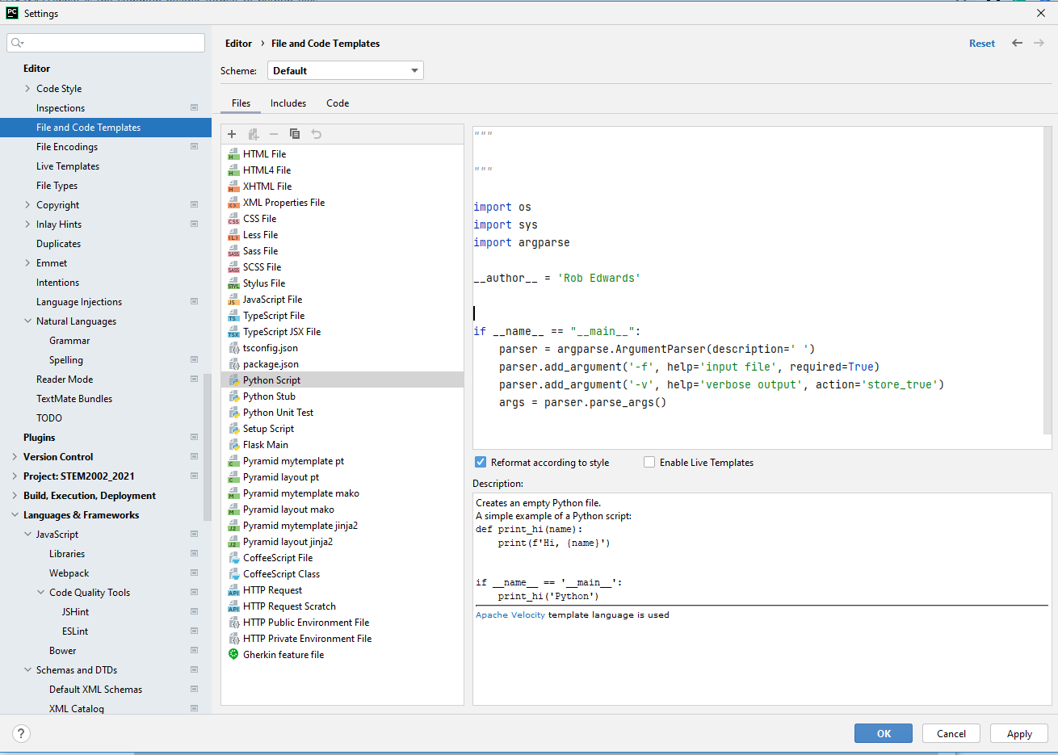
Automatically write python code

